Slide 1
Cultural Analytics

Slide 2
What is CA?
Looking for cultural patterns at scale
Scale =
100s – 1000s of years
10,000s – 100,000s of books
Millions to billions words

Slide 3
But why?
Humanists study and make claims about cultural. CA allows humanist to test their claims about cultural phenomena “more empirically”
Example: Instead of reading closely a handful of British Victorian novels to understand how England thought about criminal punishment in that period, we can now look at the language of thousands of British novels over time and track language changes to validate old claims and make new ones.

Slide 4
Understanding the Ngram Viewer
Gram = unit of meaning; each unit is a string of characters separated by spaces
Unigram (1-gram) = one unit of meaning separated spaces (ie, “dog”)
Bigram (2-gram) = two units of meaning separated spaces (ie, “dog lover”
Trigram (3-gram) = three units of meaning separated spaces (ie, “dog lover like”)
Smoothing = averaging the number of times an n-gram appears over years, for example in 1919
0 = take the raw word count of n-gram for 1919 only
1 = average n-gram count of 1919 by taking the count from 1918, 1919, and 1920 divided by 3
4 = average n-gram count of 1919 by taking the count from 1915, 1916, 1917, 1918, 1919, 1920, 1921, 1922, 1923 divided by 8
Years at the left and right most edge of the graph will average only years

Slide 5
Why has CA not overtaken the Humanities
This is not just a tool; this is actually shaping the kind of questions someone in literature might even ask…It should come in a box marked ‘Handle With Care,’…
(Matthew Bevis quoted in Analyzing Literature by Words and Numbers)
Ms. Martin at Princeton knows firsthand how electronic searches can unearth both obscure texts and dead ends. She has spent the last 10 years compiling a list of books, newspaper and journal articles about the technical aspects of poetry…She recalled finding a sudden explosion of the words “syntax” and “prosody” in 1832, suggesting a spirited debate about poetic structure. But it turned out that Dr. Syntax and Prosody were the names of two racehorses…“You find 200 titles with ‘Syntax,’ and you think there must be a big grammar debate that year,” Ms. Martin said, “but it was just that Syntax was winning.”
(Meredith Martin quoted in Analyzing Literature by Words and Numbers)
Notes:
Dr. Bevis’ explains cultural analytics requires new methods for asking and answering questions in the Humanities, and those methods take time to develop and learn. Dr. Martin’s example shows that CA does not replace close reading.

Slide 6
Finding “Reliable” Data
Google Book Ngram Viewer
Compile text data from going to digital databases
Databases that allow text mining
Digital Libraries (need to OCR)
Hathi Trust
Library of Congress’ Chronicling America
Digital Public Library of America
Europeana
Project Gutenberg
Internet Archive
Notes:
Not all researchers at all institutions have access to the materials for performing CA. Many of the above resources are put together on a volunteer basis, leaving the datasets incomplete or needed improved optical character recognition (OCR) or metadata to ensure what one sees in one’s analysis is correct and not due to incomplete data or some technical or human error.

Slide 7
Need to Interpret Quantitative Results
“we must remain attentive to where and how computational data analytics crosses the line into naïve empiricism—often unwittingly… [By]…acknowledging that numbers have to be read—that is, resisting the view that statistical results are meaningful in any self-evident way—takes place by close reading of computational results and often manipulating parameters, adjusting algorithms, and rerunning the data”
(from Laura Mandell Gender and Cultural Analytics: Finding or Marking Stereotypes)
Scholars have to think carefully about their datasets, how they organize them, and the word counts they find significant or else risk suggesting cultural stereotypes as objective truth

Slide 8
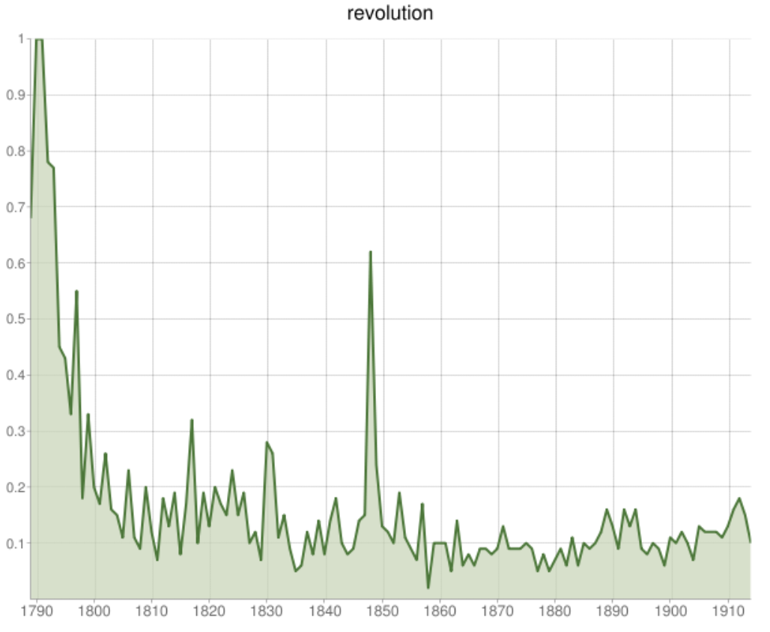
Analyzing CA
The graph to the left is from Cohen’s research in the NYT reading. The graph show the percent of all books published with the word revolution in the titles (y-axis) on a year by year basis (x-axis).
How do you interpret the graph?
What questions does this graph leave you with?

